Slide 1
OpenID Foundation Overview for CAMARA Project
Bjorn Hjelm
Vice Chairman, OpenID Foundation
June 1, 2023

Slide 2
OpenID Foundation Overview
Non-profit, international standardization organization founded in 2007
An expert and unbiased resource providing strategic guidance on the digital identity landscape and how public and private entities can build sustainable digital identity solutions to benefit users and all ecosystem participants.
Focused on the development of open internet identity and security standards to ensure robust global deployments while enabling interoperability
Committed to serving all digital users with secure and privacy preserving digital identity protocols
All OpenID standards are developed within Foundation working groups
Global community of experts that develop and validate standards through an open, consensus-based processes
OIDF standards are actively maintained, and evolve as needed to support existing and new use cases
OpenID Certification Program ensures compliant, secure and interoperable deployments
Self-certification to reduce cost and complexity
All certifications are public and low cost to facilitate transparency & ecosystem adoption
Sometimes mandated to support government policy & regulation

Slide 3
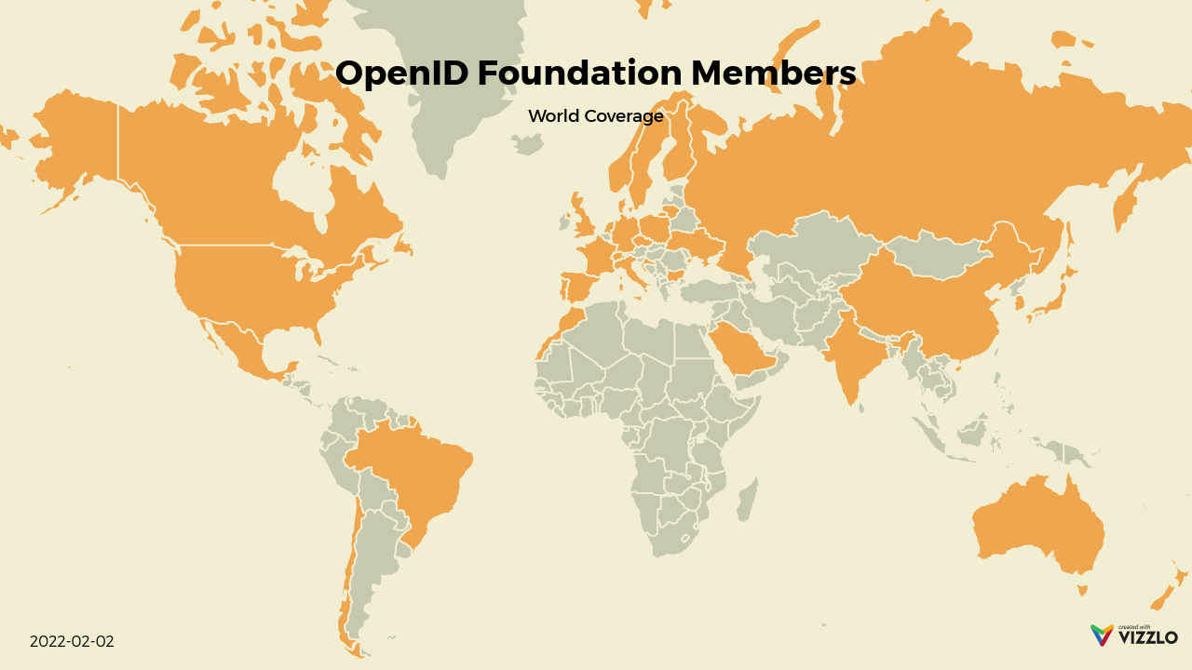

Slide 4
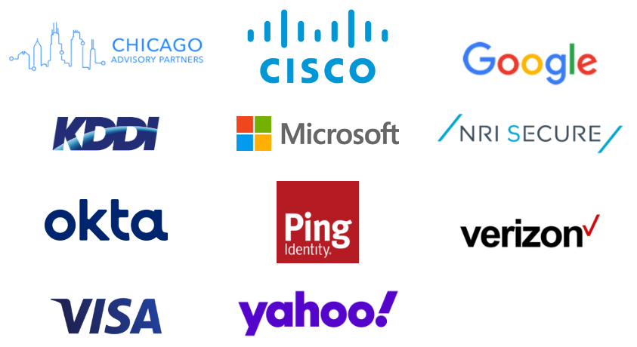
Sustaining Members
Notes:
Sponsored by these companies and organizations.
Without the contributions from these sponsors, we cannot provide the free service for spec making and IPR maintenance.

Slide 5
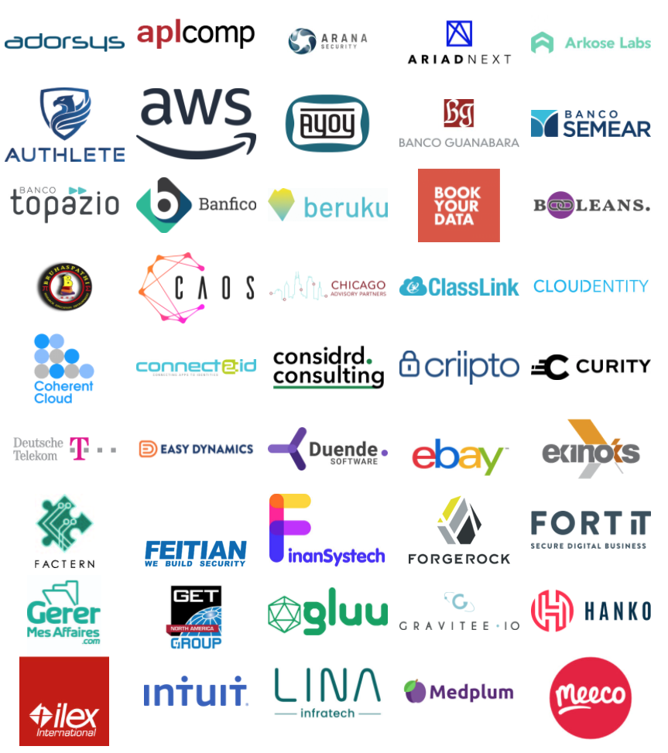
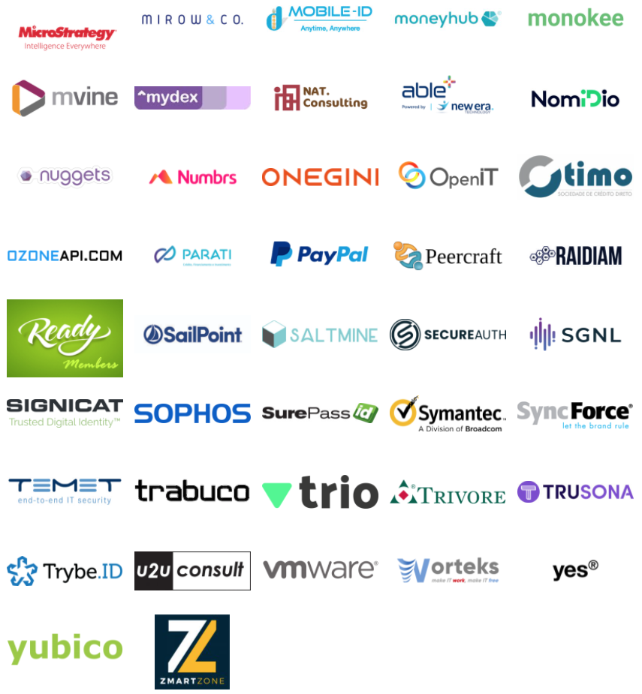
Corporate Members
Notes:
Sponsored by these companies and organizations.
Without the contributions from these sponsors, we cannot provide the free service for spec making and IPR maintenance.

Slide 6
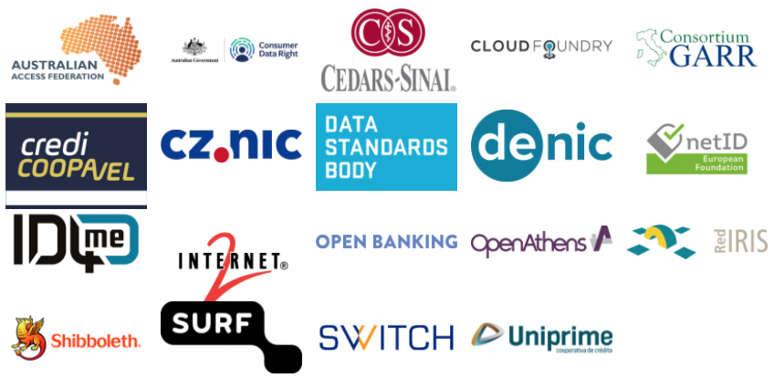
Non-Profit & Government Members
Notes:
Sponsored by these companies and organizations.
Without the contributions from these sponsors, we cannot provide the free service for spec making and IPR maintenance.

Slide 7
What OpenID Standards Can Do for MNO
MNO use cases that use OpenID Connect Standards
1. MNO as an Identity Service Provider
2. MNO that wants to Verify Attributes
3. MNOs that want to Share Signals
4. MNO as a Relying Party to Third Party Identity Services
5. MNO that need to Conform to Open Banking (Data) Regulations
6. MNO Identity Services for Employees, Systems, and Things
Each MNO will think strategically whether to engage in (1)-(3), and how they can optimize their investments in (4)-(6)

Slide 8
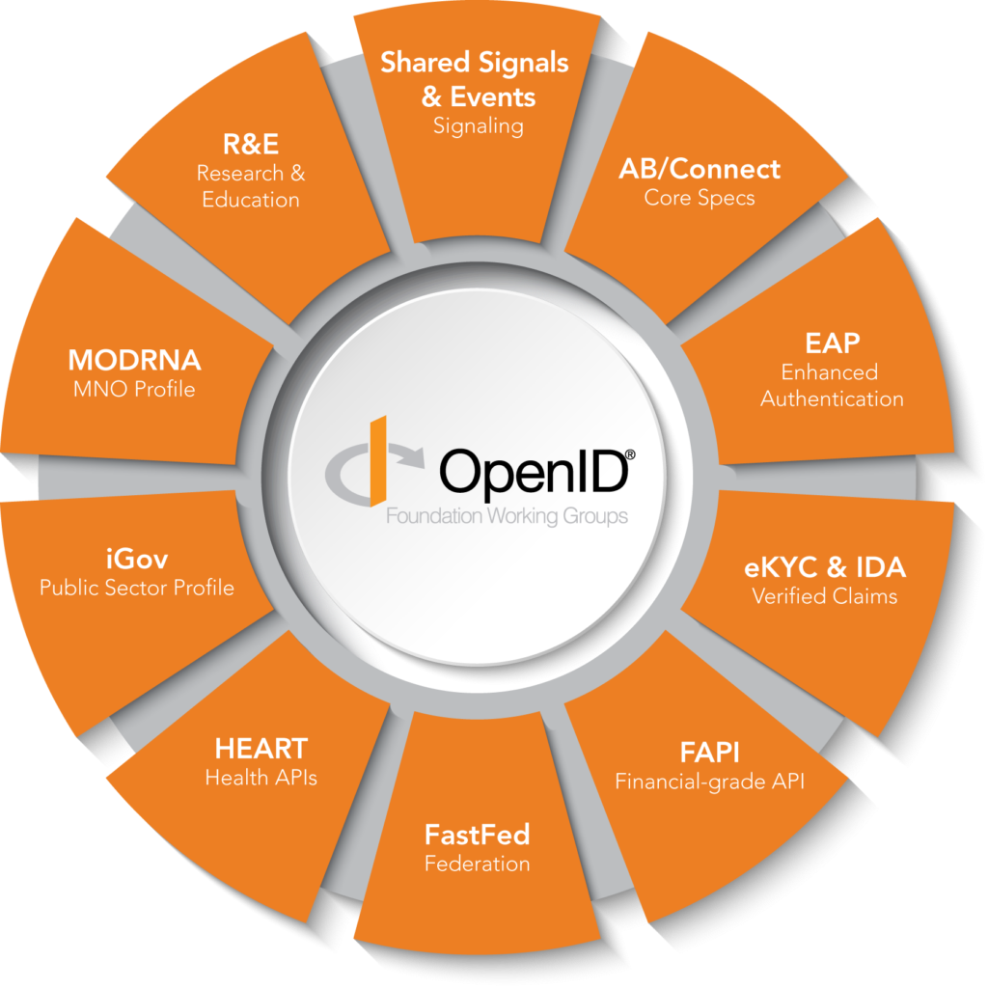
Current Working Groups
Ten (10) Foundation working groups (WGs) focused on developing OpenID standards as defined in their charters
WGs meet mostly online to share information and develop specification documentation using issue tracking systems, git repositories and mailing lists
Global community of experts that develop and validate proven standards through open, consensus-based processes

Slide 9
Working Group Highlights for CAMARA Project
MODRNA WG
Enable Mobile Network Operators (MNOs) to become Identity Providers by developing (1) a profile of and (2) an extension to OpenID Connect for use by MNOs providing identity services.
FAPI WG
Enable applications to utilize the data stored in a financial account, applications to interact with a financial account, and users to control the security and privacy settings.
eKYC-IDA WG
Extend OpenID Connect to included a standardized schema for expressing (and requesting) identity assurance metadata.
Shared Signals WG
Enable the sharing of security events, state changes, and other signals between related and/or dependent systems such as identity providers, risk engines, relying parties, device management platforms, network infrastructure, and policy engines.

Slide 10
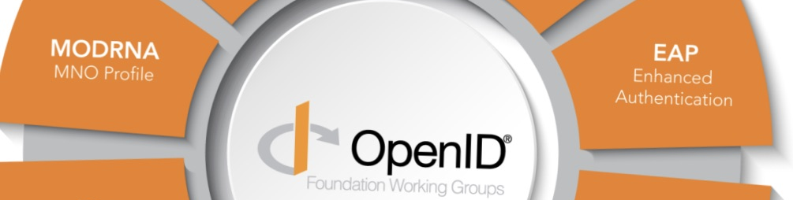
MODRNA WG
New documents include CIBA Errata, CIBA Extension and IETF draft to an IANA registry for CIBA endpoint parameters as well as discussions to create drafts for (3GPP) MCX Profile and profile for (GSMA) RCS Verification Authority API.
Active engagement in outreach activities and serve as a forum for MNO engagement in the identity services ecosystem.
Specification Status
Final Publication status:
CIBA Core
Implementer’s Draft status:
Authentication Profile
Account Porting
User Questioning API
Working Drafts status:
MODRNA CIBA Profile
Discovery Profile
Registration Profile
CIBA Core Errata
CIBA Core Extension

Slide 11
FAPI WG
Specification Status
Final Publication status:
FAPI 1.0 – Part 1: Baseline
FAPI 1.0 Part 2: Advanced
JARM (JWT Secured Authorization Response Mode for OAuth 2.0)
Implementer’s Draft status:
FAPI CIBA Profile
FAPI 2.0 Security Profile
FAPI 2.0 Attacker Model
Grant Management for OAuth 2.0
Working Drafts status:
FAPI 2.0 Message Signing

Slide 12
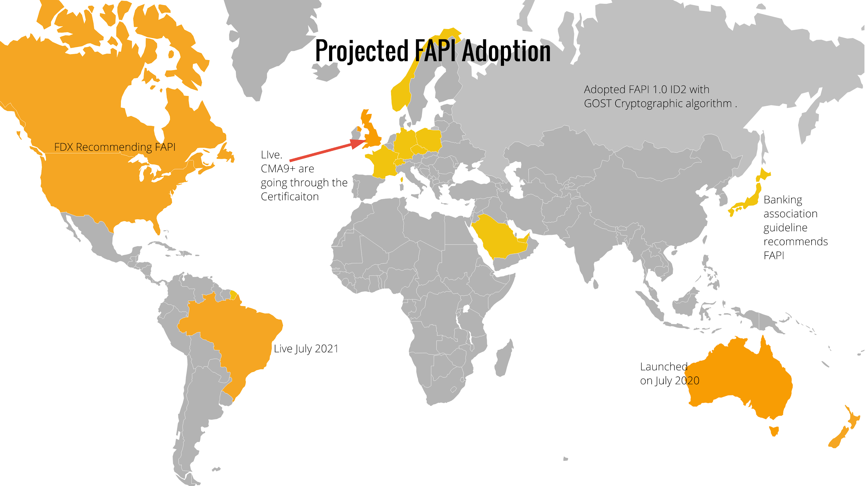
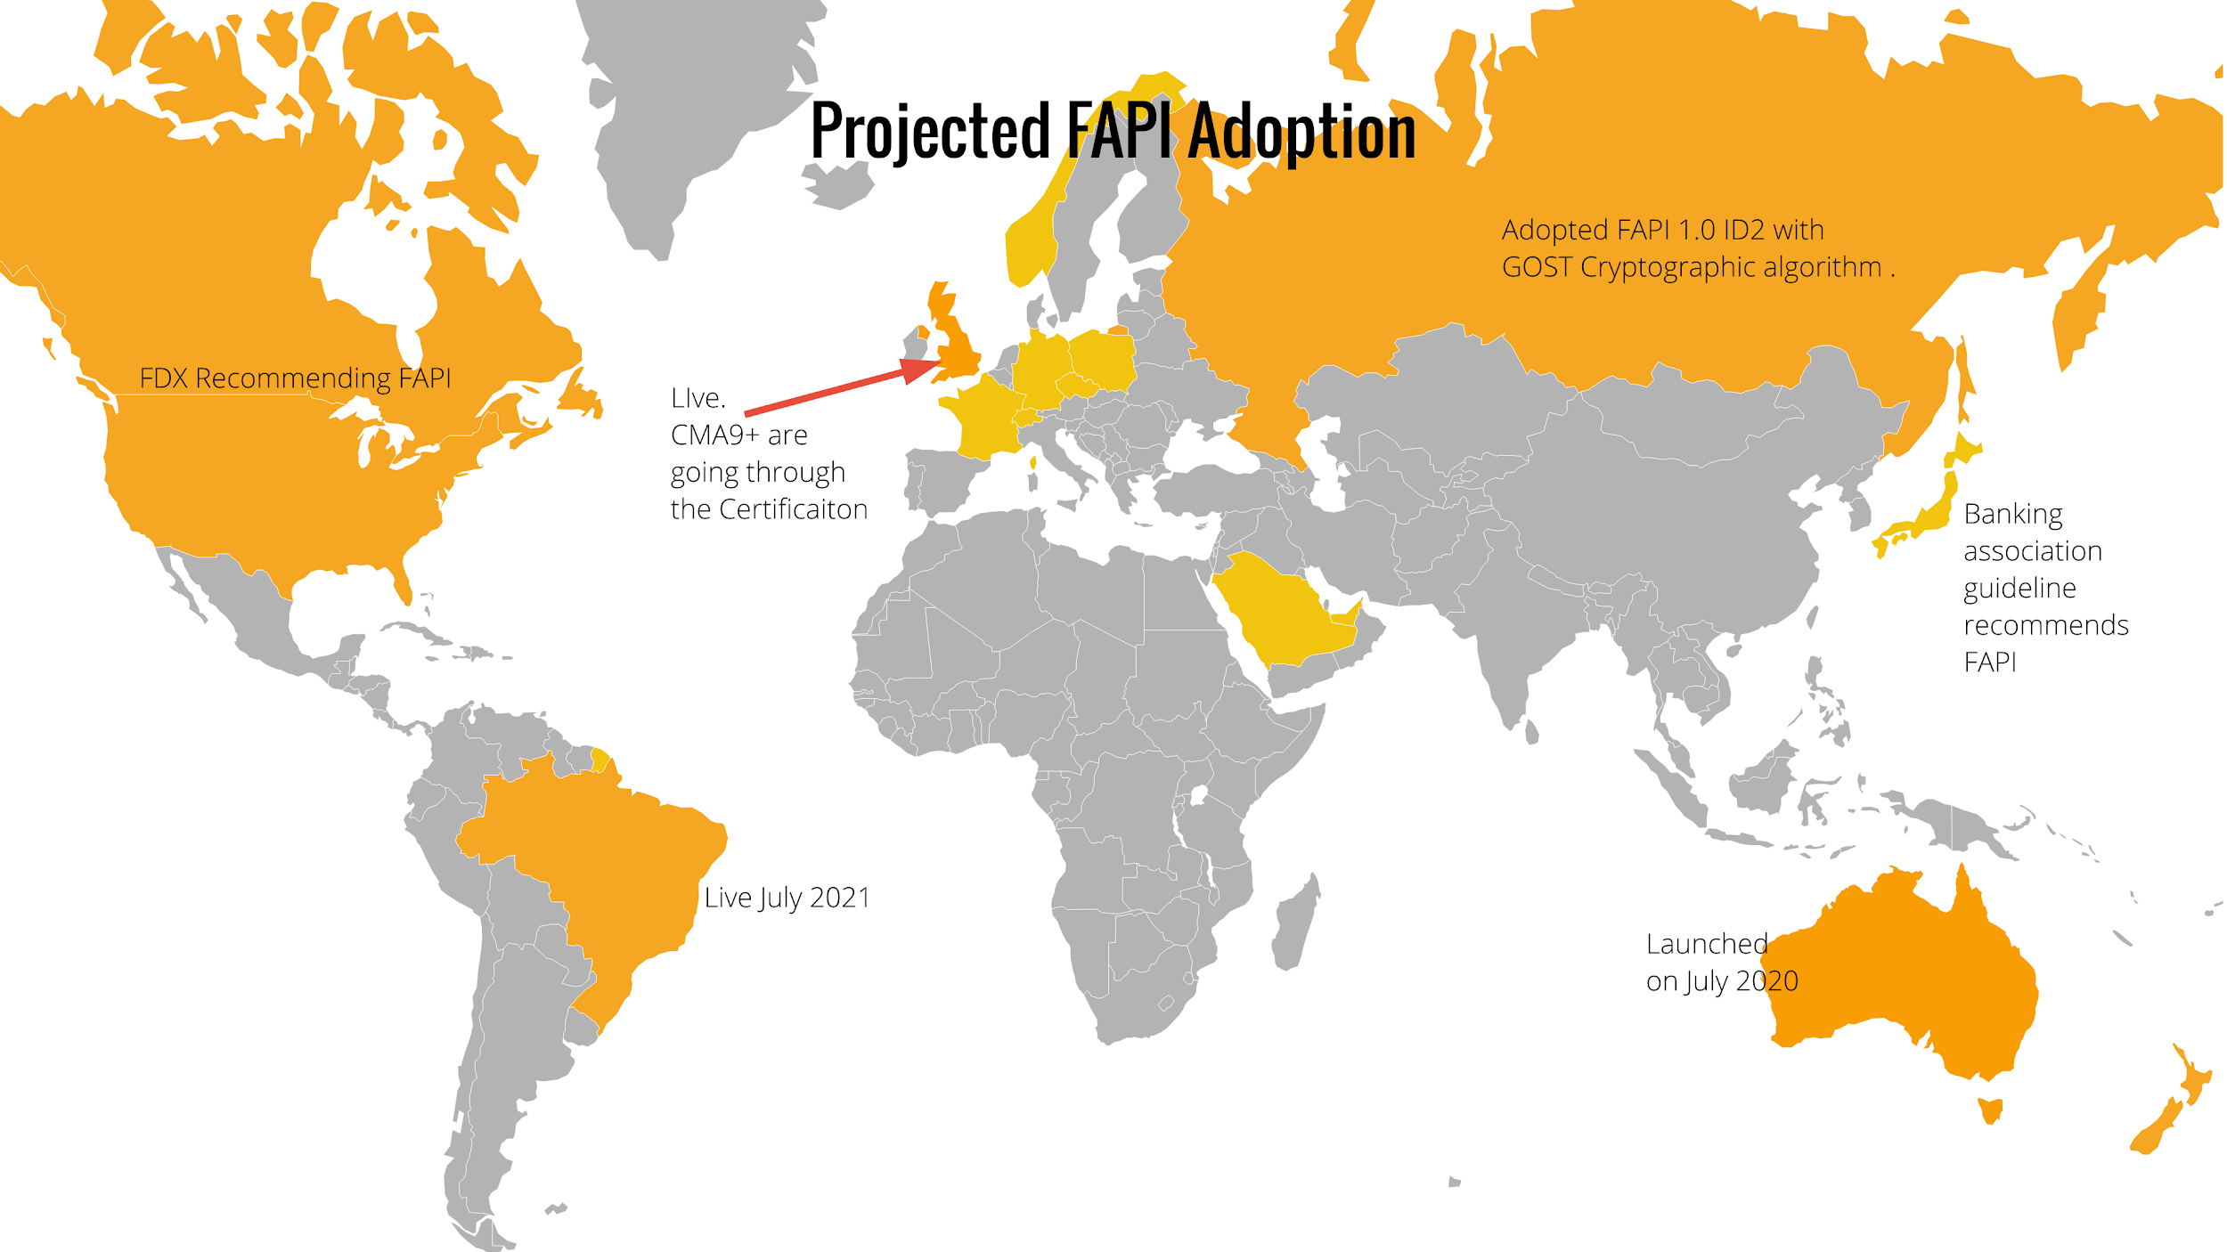
FAPI Global Deployment
Notes:
Is that it really happens and US and Canada go green.

Slide 13
Consent Management in FAPI
A complete security protocol requires a holistic approach.
Specify authorization (including fine grained)
Rich Authorization Requests (RFC 9396).
Management of existing consents
Grant Management for OAuth 2.0
Client awareness for complex approval process (e.g. every data holder needs to approve).
Extension to Grant Management for OAuth 2.0.
Grant Management
Grant: the set of permissions confirmed by the owner of services or data for a certain client
Typically related to an access token and a refresh token (but invisible to client)
Objectives of Grant Management
Make grant (status) accessible and manageable by clients
Support concurrent, independent grants

Slide 14
eKYC-IDA WG
eKYC-IDA WG
The group is developing extensions to OpenID Connect that will standardize the communication of assured identity information, i.e. verified claims and information about how the verification was done and how the respective claims are maintained.
Specification Status
Implementers Draft status:
OpenID Connect for Identity Assurance 1.0
….

Slide 15
Shared Signals WG
The Shared Signals Framework is:
Continuous Access Evaluation Protocol (CAEP), specified as a profile of the SSE Framework, facilitates zero-trust security by describing status changes (CAEP events) expressed as security event tokens (SET).
Risk Incident Sharing and Coordination (RISC) provides a standardized way to transmit and receive security alerts about such attacks. It enables providers to prevent attackers from compromising linked accounts across multiple providers and coordinate in restoring accounts in the event of compromise.
Specification Status
Implementer’s Draft status.
OpenID Shared Signals and Events Framework 1.0
OpenID Continuous Access Evaluation Profile 1.0
OpenID RISC Profile 1.0

Slide 16
OpenID Certification Program

Slide 17
OpenID Certification Program Overview
The OpenID Foundation enables deployments of OpenID Connect to be certified to specific conformance profiles to promote interoperability among implementations.
The OpenID Foundation’s certification process utilizes self-certification and conformance test suites developed by the Foundation.
All certified implementations are openly listed at https://openid.net/developers/certified/

Slide 18
Certification Program Resources
Conformance Suite source code etc publicly available on gitlab:
https://gitlab.com/openid/conformance-suite
Instructions for testing/certifying:
https://openid.net/certification/instructions/
Notes notes about the KSA/SAMA tests:
OP testing: https://openid.net/certification/fapi_op_testing/#ksa
RP testing: https://openid.net/certification/fapi_rp_testing/#ksa
Production deployment:
https://www.certification.openid.net/
(Login with any google/gitlab/openid account)
Contact the OpenID Foundation certification team if you require help: certification@oidf.org

Slide 19
Global Assured Identity Network (GAIN)

Slide 20


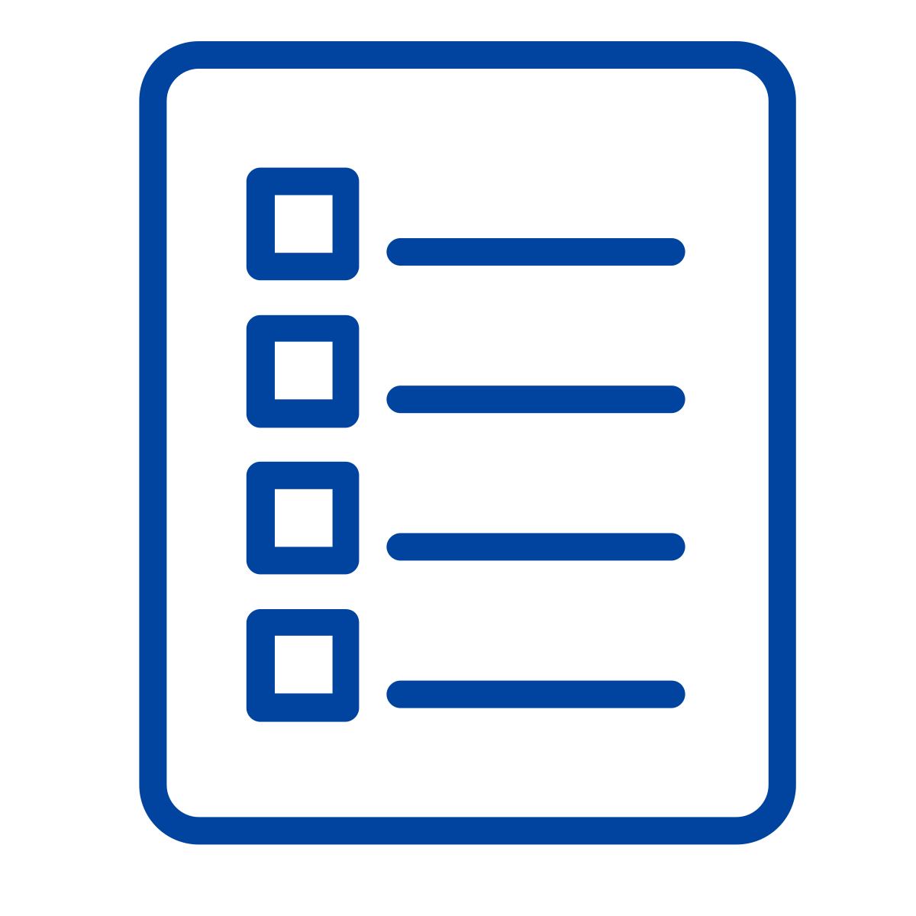


GAIN Principles
Global
Interoperability
Technology
Agnostic
Open
Standards
Distributed
Governance
Internet
Scale
“Build on what’s been built”

Slide 21
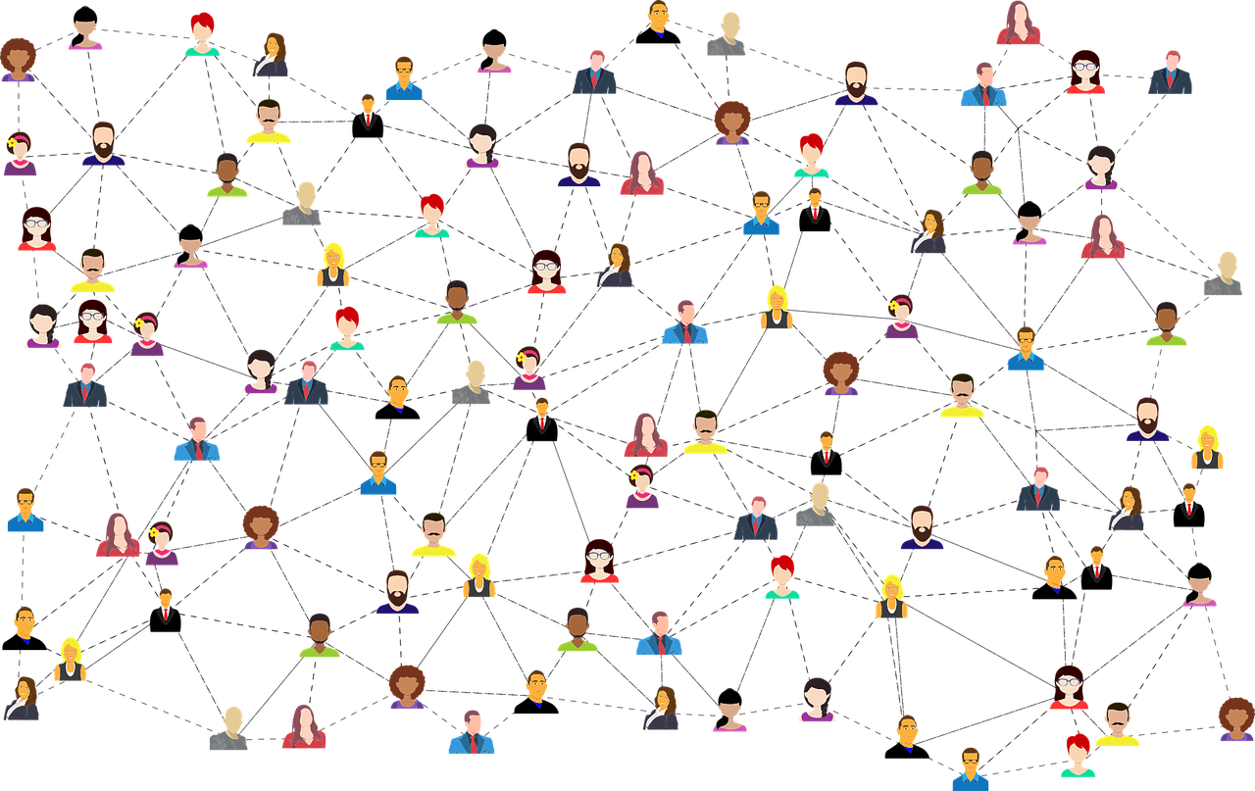
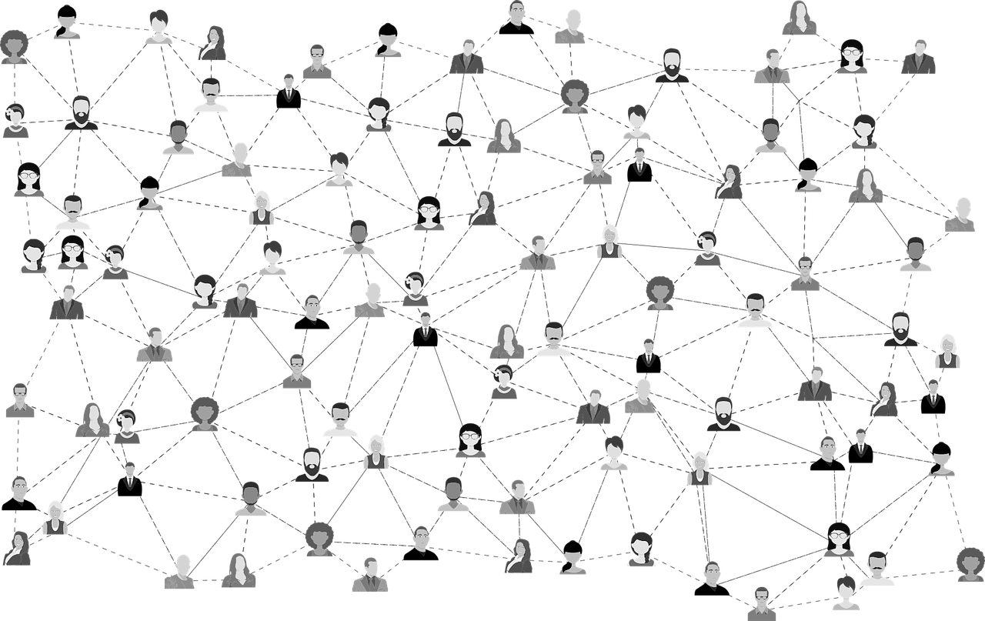

The GAIN hypothesis for global interoperability
Globally interoperable network for high-trust identity assurance.
Trusted Network
Inter-
Connection
The
<untrusted> Internet

Slide 22
The Governance of GAIN
Open Identity Exchange
Global Interoperability Working Group
Dedicated to interoperability in the policy domain
Global Legal Entity Identifier Foundation
OpenID Foundation
GAIN Proof of Concept Community Group
Testing technical standards of interoperability
Cloud Signature Consortium
Secure Identity
Alliance
Institute of International Finance
GAIN Guiding Body
Those organizations that have signed the Memorandum of Understanding and committed to certain contributions to the effort.

Slide 23


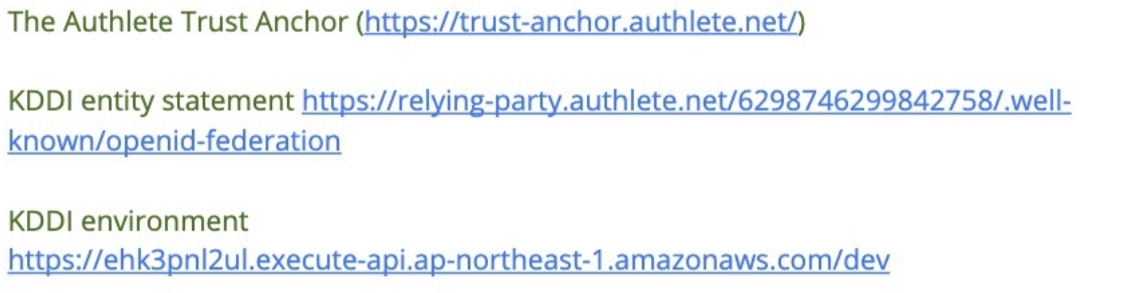


GAIN POC
Authlete (Japan)
RP
IDP
Federation
Interface
Italian Federation
RP
IDP
Federation
Interface
(inbount)
RP
IDP
Federation
Interface
participant lookup
Federation
Adaptor
(outbound)

